Slide 1

Software Engineering (CS34102)
Software Requirements & SRS
Course Coordinator:
Prof. (Dr.) D.S. Kushwaha
Course Instructor: Akanksha Gaur
Department of Computer Science and Engineering
MNNIT, Allahabad

Slide 2
Contents
What is a requirement?
Types of Requirements
Requirement Readers
Functional, Non-Functional Requirements & Domain Requirements
Requirement Engineering Process
Software Requirement Specification

Slide 3
What is a requirement?
Software requirements are the description of features and functionalities of the target system.
Requirements convey the expectations of users from the software product.
The requirements can be obvious or hidden, known or unknown, expected or unexpected from client’s point of view.

Slide 4
What is a requirement?
According to IEEE standard 729, a requirement is defined as follows:
A condition or capability needed by a user to solve a problem or achieve an objective
A condition or capability that must be met or possessed by a system or system component to satisfy a contract, standard, specification or other formally imposed documents
A documented representation of a condition or capability as in 1 and 2.

Slide 5
Types of Software Requirements
User Requirements
Statements in natural language plus diagrams of the services the system provides and its operational constraints.
Written for customers
System Requirements
A structured document setting out detailed descriptions of the system services.
Written as a contract between client and contractor

Slide 6
Types of Software Requirements
Business Requirements
Critical activities of an enterprise that must be performed to meet the organizational objective(s) while remaining solution independent.

Slide 7
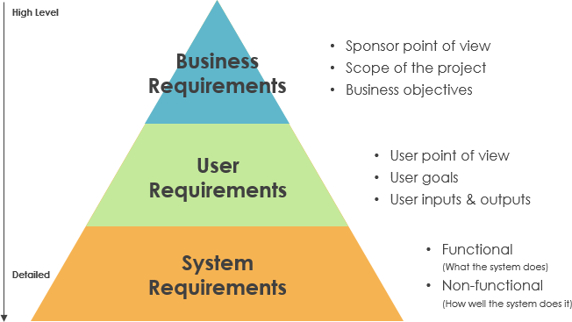

Slide 8
Sources of Understanding Software Requirements
Stakeholders/Buyers
User/Beneficiaries
Operator
Domain Experts
Developers
Automated Tools
Past Experience/Case Studies
Connected People/Machine/ Environment
Tester

Slide 9
Requirements Reader
Client Managers
System End-users
Client Engineers
Contractor Managers
System Architects
User Requirements
System End-users
Client Engineers
System Architects
Software Developers
System Requirements
Software Design Specification
Client Engineers
System Architects
Software Developers

Slide 10
Functional & Non-Functional Requirements
Functional requirements
Statements of services the system should provide, how the system should react to particular inputs and how the system should behave in particular situations.
Non-functional requirements
Constraints on the services or functions offered by the system such as timing, development process, standards, etc.
Domain requirements
Application domain of the system and that reflect characteristics of that domain.

Slide 11
Functional requirements
End user specifically demands as basic facilities that the system should offer.
All these functionalities need to be necessarily incorporated into the system as a part of the contract.
These are represented or stated in the form of input to be given to the system, the operation performed and the output expected.

Slide 12
Functional Requirements
There are many ways of expressing functional requirements e.g., natural language, a structured or formatted language with no rigorous syntax and formal specification language with proper syntax.
They are basically the requirements stated by the user which one can see directly in the final product, unlike the non-functional requirements.

Slide 13
Functional requirements - Advantages
Helps check whether the application is providing all the functionalities that were mentioned in the functional requirement of that application
A FR document helps define the functionality of a system or one of its subsystems.
Functional requirements along with requirement analysis help identify missing requirements.
They help clearly define the expected system service and behavior.

Slide 14
Functional requirements - Advantages
Errors caught in the Functional requirement gathering stage are the cheapest to fix.
Support user goals, tasks, or activities for easy project management
Functional requirement can be expressed in Use Case form or user story as they exhibit externally visible functional behavior.

Slide 15
Functional requirements - examples
Search option given to user to search from various invoices.
User should be able to mail any report to management.
Users can be divided into groups and groups can be given separate rights.
Should comply business rules and administrative functions.
Software is developed keeping downward compatibility intact.

Slide 16
Problem - Requirements Imprecision
Problems arise when requirements are not precisely stated
Ambiguous requirements may be interpreted in different ways by developers and users
Consider the term ‘appropriate viewers’
User intention - special purpose viewer for each different document type
Developer interpretation - Provide a text viewer that shows the contents of the document

Slide 17
Problem - Completeness & Consistency
In principle, requirements should be both:
Complete
They should include descriptions of all facilities required
Consistent
There should be no conflicts or contradictions in the descriptions of the system facilities
In practice, it is impossible to produce a complete and consistent requirements document.

Slide 18
Non-Functional Requirements
These are basically the quality constraints that the system must satisfy according to the project contract.
The priority or extent to which these factors are implemented varies from one project to other. They are also called non-behavioral requirements.

Slide 19
Non-Functional Requirements
The process of specifying non-functional requirements requires the knowledge of the functionality of the system, as well as the knowledge of the context within which the system will operate.

Slide 20
Non-Functional Requirements
They basically deal with issues like:
Portability
Security
Maintainability
Reliability
Scalability
Performance
Reusability
Flexibility

Slide 21
Non-Functional Requirements
NFR’s are classified into following types:
Interface constraints
Performance constraints: response time, security, storage space, etc.
Operating constraints
Life cycle constraints: maintainability, portability, etc.
Economic constraints

Slide 22
Non-Functional Requirements - Classification
Product requirements
Requirements which specify that the delivered product must behave in a particular way e.g. execution speed, reliability, etc.

Slide 23
Non-Functional Requirements - Classification
Organizational requirements
Requirements which are a consequence of organizational policies and procedures e.g. process standards used, implementation requirements, etc.

Slide 24
Non-Functional Requirements - Classification
External requirements
Requirements which arise from factors which are external to the system and its development process e.g. interoperability requirements, legislative requirements, etc.

Slide 25
Non-Functional Requirements - Advantages
The nonfunctional requirements ensure the software system follow legal and compliance rules.
They ensure the reliability, availability, and performance of the software system
They ensure good user experience and ease of operating the software.
They help in formulating security policy of the software system.

Slide 26
Parameters | Functional Requirement | Non-Functional Requirement
Requirement | Mandatory | Non-mandatory
Capturing type | Captured in use case | captured as a quality attribute
End-result | Product feature | Product properties
Capturing | Easy | Hard
Objective | Helps you verify the functionality of the software. | Helps you to verify the performance of the software.
Area of focus | Focus on user requirement | Concentrates on the user's expectation.
Documentation | Describe what the product does | Describes how the product works
Type of Testing | Functional Testing like System, Integration, End to End, API testing, etc. | Non- Functional Testing like Performance, Stress, Usability, Security testing, etc.
Test Execution | Test Execution is done before non-functional testing. | After the functional testing
Product Info | Product Features | Product Properties

Slide 27
Domain requirements
The requirements which are characteristic of a particular category or domain of projects.
The basic functions that a system of a specific domain must necessarily exhibit come under this category.
For instance, in an academic software that maintains records of a school or college, the functionality of being able to access the list of faculty and list of students of each grade is a domain requirement.
These requirements are therefore identified from that domain model and are not user specific.

Slide 28
Logical Classification
Must Have: Software cannot be said operational without them.
Should have: Enhancing the functionality of software.
Could have: Software can still properly function with these requirements.
Wish list: These requirements do not map to any objectives of software.

Slide 29
User Interface requirements
UI is an important part of any software or hardware or hybrid system. A software is widely accepted if it is -
easy to operate
quick in response
effectively handling operational errors
providing simple yet consistent user interface

Slide 30
User Interface requirements
Content Presentation | Easy Navigation
Responsive | Simple Interface
Consistent UI elements | Purposeful layout
Feedback mechanism | Provide help information
Default settings | Group based view settings
User centric approach | Strategical use of color and texture

Slide 31
Software System Analyst
System analyst in an IT organization is a person, who analyzes the requirement of proposed system and ensures that requirements are conceived and documented properly & correctly.
Role of an analyst starts during Software Analysis Phase of SDLC.

Slide 32
Software System Analyst - Responsibilities
Analyzing and understanding requirements
Understanding project’s contribution to organization objectives
Identify sources of requirement
Validation of requirement

Slide 33
Software System Analyst - Responsibilities
Develop and implement requirement management plan
Documentation
Coordination with clients to prioritize requirements and remove and ambiguity
Finalizing acceptance criteria with client and other stakeholders

Slide 34
Software Metrics and Measures
Software Measures can be understood as a process of quantifying and symbolizing various attributes and aspects of software.
Software Metrics provide measures for various aspects of software process and software product.
Software Measures are fundamental requirement of software engineering.
They not only help to control the software development process but also aid to keep quality of ultimate product excellent.

Slide 35
Software Metrics and Measures
Size Metrics
LOC (Lines of Code), mostly calculated in thousands of delivered source code lines, denoted as KLOC.
Function Point Count is measure of the functionality provided by the software.
Function Point count defines the size of functional aspect of software.

Slide 36
Software Metrics and Measures
Complexity Metrics
McCabe’s Cyclomatic complexity quantifies the upper bound of the number of independent paths in a program, which is perceived as complexity of the program or its modules.
It is represented in terms of graph theory concepts by using control flow graph.

Slide 37
Software Metrics and Measures
Quality Metrics
Defects, their types and causes, consequence, intensity of severity and their implications define the quality of product.
The number of defects found in development process and reported by the client after the product is installed or delivered at client-end, define quality of product.

Slide 38
Software Metrics and Measures
Process Metrics
In various phases of SDLC, the methods and tools used, the company standards and the performance of development are software process metrics.
Resource Metrics
Effort, time and various resources used, represents metrics for resource measurement.

Slide 39
Requirement Engineering
RE refers to the process of defining, documenting, and maintaining requirements in the engineering design process.
Thus, requirement engineering is the disciplined application of proven principles, methods, tools, and notation to describe a proposed system's intended behavior and its associated constraints.

Slide 40
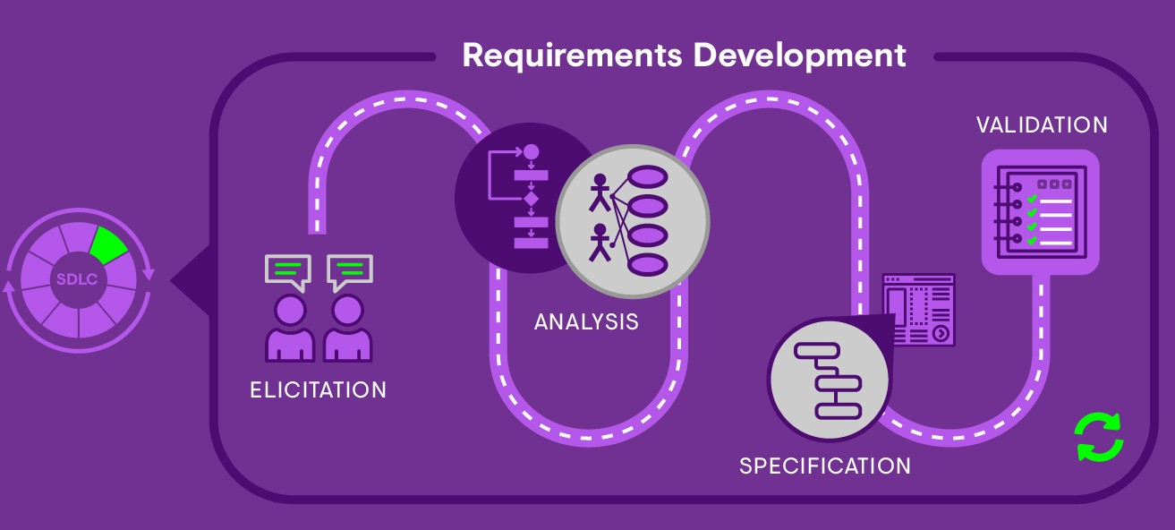
Requirement Engineering

Slide 41
Requirement Engineering
It provides the appropriate mechanism to understand what the customer desires, analyzing the need, and assessing feasibility, negotiating a reasonable solution, specifying the solution clearly, validating the specifications and managing the requirements as they are transformed into a working system.

Slide 42
Requirement Engineering Process
It is a five-step process, which includes -
Feasibility Study
Requirement Elicitation and Analysis
Software Requirement Specification
Software Requirement Validation
Software Requirement Management

Slide 43
Requirements Elicitation & Analysis
Feasibility Study
Requirement Specification
Feasibility Report
System Models
Requirements Validation
User & System Requirements
Requirements Document
Requirement Engineering Process
43

Slide 44
1. Feasibility Study
The objective behind the feasibility study is to create the reasons for developing the software that is acceptable to users, flexible to change and conformable to established standards.

Slide 45
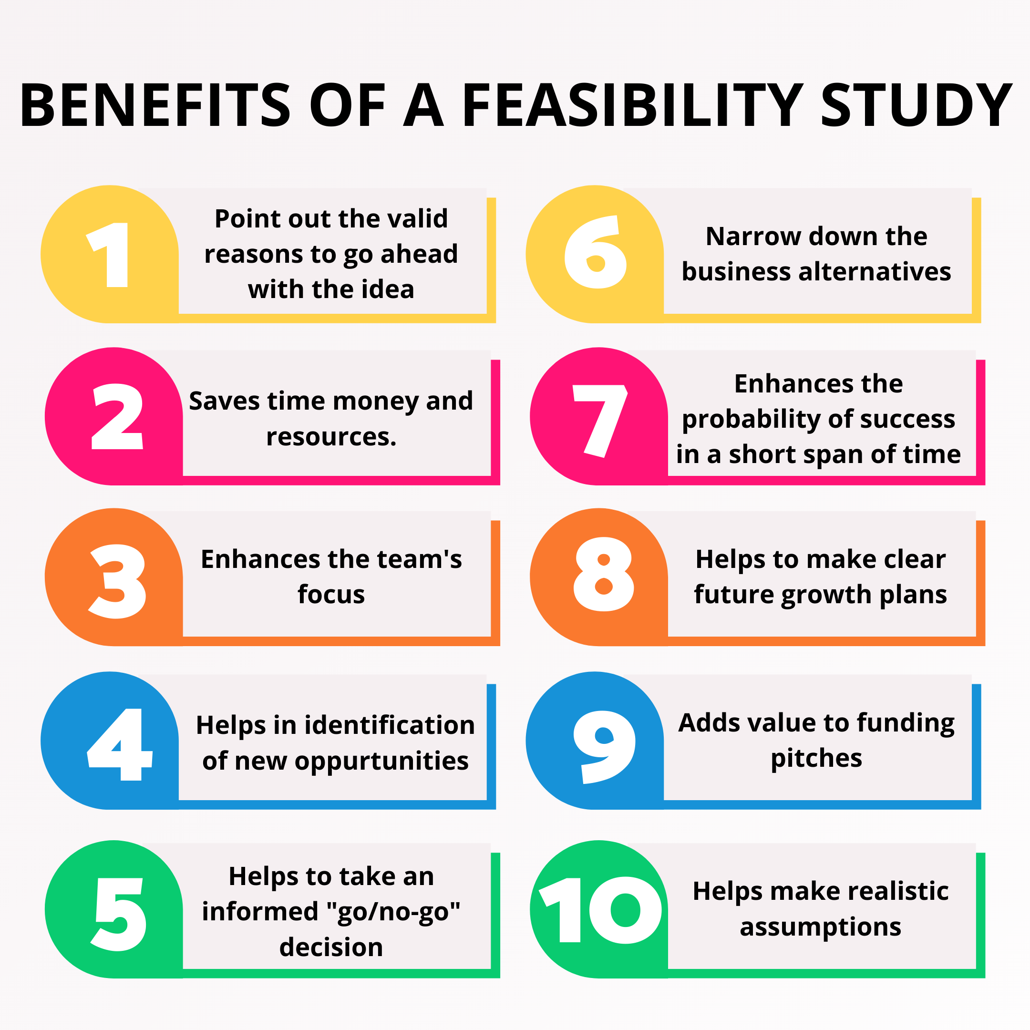

Slide 46
Types of Feasibility
Technical Feasibility
It evaluates the current technologies, which are needed to accomplish customer requirements within the time and budget.
Operational Feasibility
It assesses the range in which the required software performs a series of levels to solve business problems and customer requirements.
Economic Feasibility
It decides whether the necessary software can generate financial profits for an organization.

Slide 47
2. Requirement Elicitation and Analysis
This is also known as the gathering of requirements. Here, requirements are identified with the help of customers and existing systems processes, if available.
Analysis of requirements starts with requirement elicitation.
The requirements are analyzed to identify inconsistencies, defects, omission, etc. We describe requirements in terms of relationships and also resolve conflicts if any.

Slide 48
Problems of Elicitation and Analysis
Getting all, and only, the right people involved.
Stakeholders often don't know what they want
Stakeholders express requirements in their terms.
Stakeholders may have conflicting requirements.
Requirement change during the analysis process.
Organizational and political factors may influence system requirements.

Slide 49
Requirement Elicitation Process
Requirements gathering
The developers discuss with the client and end users and know their expectations from the software.
Organizing Requirements
The developers prioritize and arrange the requirements in order of importance, urgency and convenience.

Slide 50
Requirement Elicitation Process
Negotiation & discussion
If requirements are ambiguous, it is then negotiated and discussed with stakeholders. Requirements may then be prioritized and reasonably compromised.
The requirements come from various stakeholders. To remove the ambiguity and conflicts, they are discussed for clarity and correctness.
Unrealistic requirements are compromised reasonably.

Slide 51
Documentation
All formal & informal, functional and non-functional requirements are documented and made available for next phase processing.
Requirement Elicitation Process

Slide 52
Requirement Definition and Specification
Requirement Validation
Domain Understanding
Prioritization
Process Entry
Requirement Collection
Conflict Resolution
Classification

Slide 53
REQUIREMENT
ELICITATION TECHNIQUES
QUESTIONNAIRE
WALKTHROUGH
TASK ANALYSIS
DOMAIN ANALYSIS
BRAINSTORMING
OBSERVATION
PROTOTYPING
SURVEYS
AUTOMATED CONSISTENCY ANALYSIS
TEST CASE GENERATION
INTERVIEWS

Slide 54
Requirement Elicitation Techniques
Interviews
Interviews are strong medium to collect requirements.
Organization may conduct several types of interviews such as:
Structured (closed) interview
Non-structured (open) interviews
Written interviews
One-to-one interviews
Group interviews

Slide 55
Requirement Elicitation Techniques
Surveys
Organization may conduct surveys among various stakeholders by querying about their expectation and requirements from the upcoming system.

Slide 56
Requirement Elicitation Techniques
Questionnaires
A document with pre-defined set of objective questions and respective options is handed over to all stakeholders to answer, which are collected and compiled.
A shortcoming of this technique is, if an option for some issue is not mentioned in the questionnaire, the issue might be left unattended.

Slide 57
Requirement Elicitation Techniques
Task analysis
Team of engineers and developers may analyze the operation for which the new system is required.
If the client already has some software to perform certain operation, it is studied and requirements of proposed system are collected.

Slide 58
Requirement Elicitation Techniques
Domain Analysis
Every software falls into some domain category.
The expert people in the domain can be a great help to analyze general and specific requirements.

Slide 59
Requirement Elicitation Techniques
Brainstorming
An informal debate is held among various stakeholders and all their inputs are recorded for further requirements analysis.

Slide 60
Requirement Elicitation Techniques
Observation
Team of experts visit the client’s organization or workplace.
They observe the actual working of the existing installed systems.
They observe the workflow at client’s end and how execution problems are dealt.
The team itself draws some conclusions which aid to form requirements expected from the software.

Slide 61
Requirement Elicitation Techniques
Prototyping
In this validation techniques the prototype of the system is presented before the end-user or customer, they experiment with the presented model and check if it meets their need.
This type of model is generally used to collect feedback about the requirement of the user.

Slide 62
Requirement Elicitation Techniques
Walk-through
It does not have a formally defined procedure and does not require a differentiated role assignment.
Checking early whether the idea is feasible or not.
Obtaining the opinions and suggestion of other people.
Checking the approval of others and reaching an agreement.

Slide 63
Requirement Elicitation Techniques
Automated Consistency Analysis
This approach is used for automatic detection of an error, such as nondeterminism, missing cases, a type error, and circular definitions, in requirements specifications.
First, the requirement is structured in formal notation then CASE tool is used to check in-consistency of the system.
The report of all inconsistencies is identified and corrective actions are taken.

Slide 64
Requirement Elicitation Techniques
Test Case Generation
Requirement mentioned in SRS document should be testable, the conducted tests reveal the error present in the requirement.
It is generally believed that if the test is difficult or impossible to design than, this usually means that requirement will be difficult to implement and it should be reconsidered.

Slide 65
3. Software Requirement Specification
Software requirement specification is a kind of document which is created by a software analyst after the requirements collected from the various sources - the requirement received by the customer written in ordinary language.
It is the job of the analyst to write the requirement in technical language so that they can be understood and beneficial by the development team.

Slide 66
Software Requirement Specification
The purpose of the software being developed
An overall description of the software
The functionality of the software or what it is supposed to do
Performance of the software in a production situation

Slide 67
Software Requirement Specification
Non-functional requirements
External interfaces or how the software will interact with hardware or other software it must connect to
Design constraints or the limitations of the environment that the software will run in

Slide 68
Software Requirement Specification
The models used at this stage include:
ER diagrams
Data Flow Diagrams (DFDs)
Function Decomposition Diagrams (FDDs)
Data Dictionaries

Slide 69
Data Flow Diagrams
DFDs are used widely for modeling the requirements. DFD shows the flow of data through a system.
The system may be a company, an organization, a set of procedures, a computer hardware system, a software system, or any combination of the preceding.
The DFD is also known as a data flow graph or bubble chart.

Slide 70
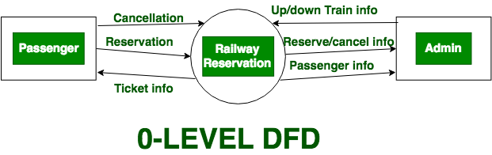

Slide 71
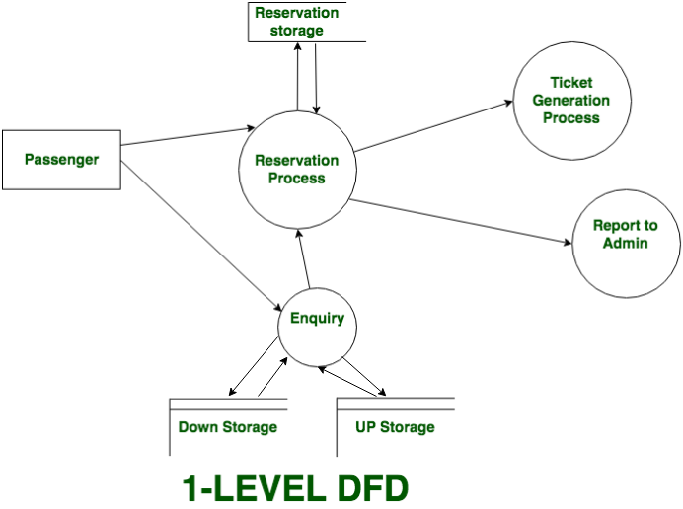

Slide 72
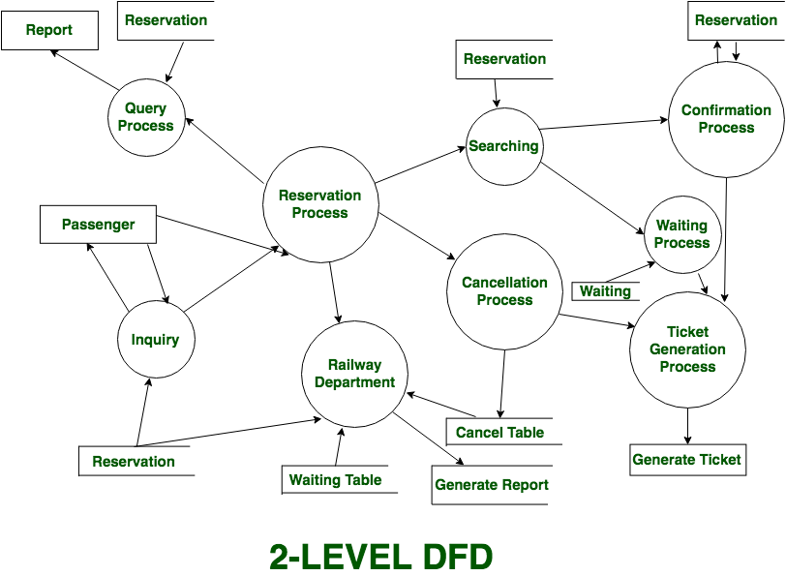

Slide 73
Data Dictionaries
Data Dictionaries are simply repositories to store information about all data items defined in DFDs.
At the requirements stage, the data dictionary should at least define customer data items, to ensure that the customer and developers use the same definition and terminologies.

Slide 74
Data Dictionaries - Uses
Create an ordered listing of all data items
Create an ordered listing of a subset of data items
Find a data item name from a description
Design the software and test cases

Slide 75
Entity-Relationship Diagrams
Another tool for requirement specification is the entity-relationship diagram, often called an "E-R diagram.“
It is a detailed logical representation of the data for the organization and uses three main constructs i.e. data entities, relationships, and their associated attributes.

Slide 76
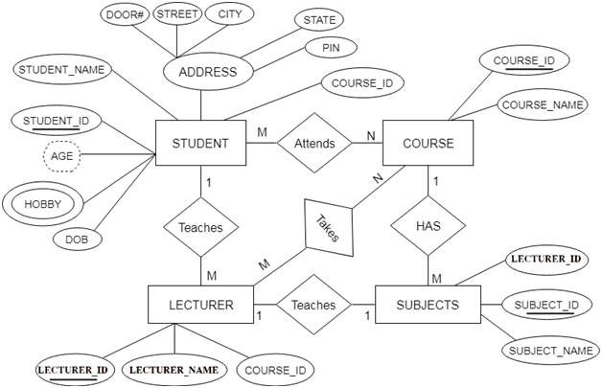

Slide 77
4. Software Requirement Validation
After requirement specifications developed, the requirements discussed in this document are validated.
The user might demand illegal, impossible solution or experts may misinterpret the needs.

Slide 78
Software Requirement Validation
Requirements can be the check against the following conditions -
If they can practically implement
If they are correct and as per the functionality and specially of software
If there are any ambiguities
If they are full
If they can describe

Slide 79
Software Requirement Validation
Quality
Model
Organizational Standard
Requirements Document
Requirement Validation
Valid Model
Organizational Rules
History Validation
Negotiation Inquiry
Problem List
Stakeholders

Slide 80
Requirements Validation Techniques
Requirements reviews/inspections: Systematic manual analysis of the requirements.
Prototyping: Using an executable model of the system to check requirements.
Test-case generation: Developing tests for requirements to check testability.
Automated consistency analysis: Checking for the consistency of structured requirements descriptions.

Slide 81
5. Software Requirement Management
It is the process of managing changing requirements during the requirements engineering process and system development.
New requirements emerge during the process as business needs a change, and a better understanding of the system is developed.
The priority of requirements from different viewpoints changes during development process.
The business and technical environment of the system changes during the development.

Slide 82
Prerequisite of Software requirements
Collection of software requirements is the basis of the entire software development project.
Hence they should be clear, correct, and well-defined.

Slide 83
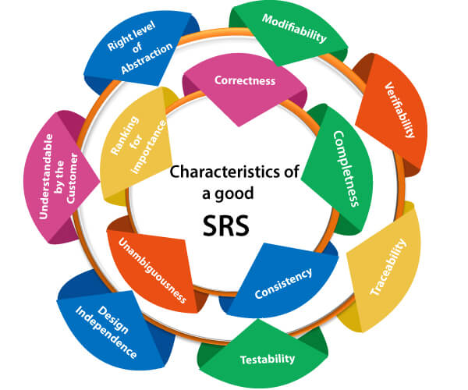

Slide 84
Characteristics of a good SRS
Correct
The correctness of the SRS is verified by the customer and developer based on the agreement they have.
The SRS should conform to the technical specifications and all other governing project documentation.

Slide 85
Characteristics of a good SRS
Unambiguous
One of the main purposes of an SRS is to eliminate miscommunication.
That’s why every requirement specification must be written to have only one possible interpretation.
It’s not unusual for an SRS to include a glossary.

Slide 86
Characteristics of a good SRS
Complete
The more complex the application, the more detailed the SRS needs to be.
A complete SRS covers every side, from performance requirements to functionality. It also sets certain limits to design.
However, it never specifies an exact design. It only offers parameters.

Slide 87
Characteristics of a good SRS
Consistent
Internal consistency means that no statements in an SRS contradict other statements in the same SRS.
This is another reason to include a glossary — so that any object, process, and specification within the document is designated with a precise term.

Slide 88
Characteristics of a good SRS
Ranked for importance and/or stability
In most cases, there are must-have requirements and would-like requirements.
It’s important for software requirements specifications to clearly label both types.
This will help developers and project managers when they create a step-by-step plan for the project.

Slide 89
Characteristics of a good SRS
Verifiable
There must be a way to test each requirement you include in the SRS.
To be considered verifiable, requirements must contain measurable and concrete concepts.

Slide 90
Characteristics of a good SRS
Modifiable
This refers to the SRS structure. In order not to disrupt the project workflow when you need to implement changes, the SRS needs to be clear and easy to change, and the requirements should not be repeated.
Traceable
It should be easy to identify the source of each requirement set out in the SRS.

Slide 91
Writing a SRS
Introduction
Purpose
Intended Audience
Intended Use
Scope
Definitions
Overall Description
User Needs
Assumptions and Dependencies
System Features and Requirements
10.1 Functional Requirements
10.2 External Interface Requirements
10.3 System Features
10.4 Non-functional Requirements

Slide 92
Steps to write Software Use Cases in an SRS
A use case describes how a user will interact with the system.
It will describe the product from the end user’s point of view in a simple story format.
Writing out use cases forces you to think through what users will do with the software and how it will respond.
It is the real-life visualization of the functional requirements.

Slide 93
Steps to write Software Use Cases in an SRS
Here are steps you can follow to write a use case:
Describe your product’s end users.
Focus on one of these users.
Break this user’s interactions down into use cases. Each interaction is a use case.
Describe the sequence of events for each use case.

Slide 94
Steps to write Software Use Cases in an SRS
Write a detailed description of the user’s actions and how the system should respond.
Expand each use case with alternate user actions and system responses.
Repeat 1-6 for each type of end-user.

Slide 95
Table of Contents
Revision History
1. Introduction
1.1 Purpose
1.2 Document Conventions
1.3 Intended Audience and Reading Suggestions
1.4 Project Scope
1.5 References
2. Overall Description
2.1 Product Perspective
2.2 Product Features
2.3 User Classes and Characteristics
2.4 Operating Environment
2.5 Design and Implementation Constraints
2.6 User Documentation
2.7 Assumptions and Dependencies
3. System Features
3.1 System Feature 1
3.2 System Feature 2 (and so on)
4. External Interface Requirements
4.1 User Interfaces
4.2 Hardware Interfaces
4.3 Software Interfaces
4.4 Communications Interfaces
5. Other Non-functional Requirements
5.1 Performance Requirements
5.2 Safety Requirements
5.3 Security Requirements
5.4 Software Quality Attributes
6. Other Requirements
Appendix A: Glossary
Appendix B: Analysis Models
Appendix C: Issues List

Slide 96
References
Software Engineering – A Practitioner’s Approach, by Pressman R.S. and Ince D
Software Engineering by Sommerville
Software Engineering Volume 1 and Volume 2 by Thayer and Christiansen
Fundamentals of Software Engineering by Rajib Mall

